Slide 1



WATER MANAGEMENT AND WASTE MANAGEMENT
PETTGEN LEA – GREGORI MARINA

Slide 2
PLAN
WATER MANAGEMENT
Definitions
Use of water
Access to water
Water distribution in the world
Problems
Solutions
Comparative statistics
WASTE MANAGEMENT
Definitions
Classification of waste
Waste production
Waste disposal

Slide 3
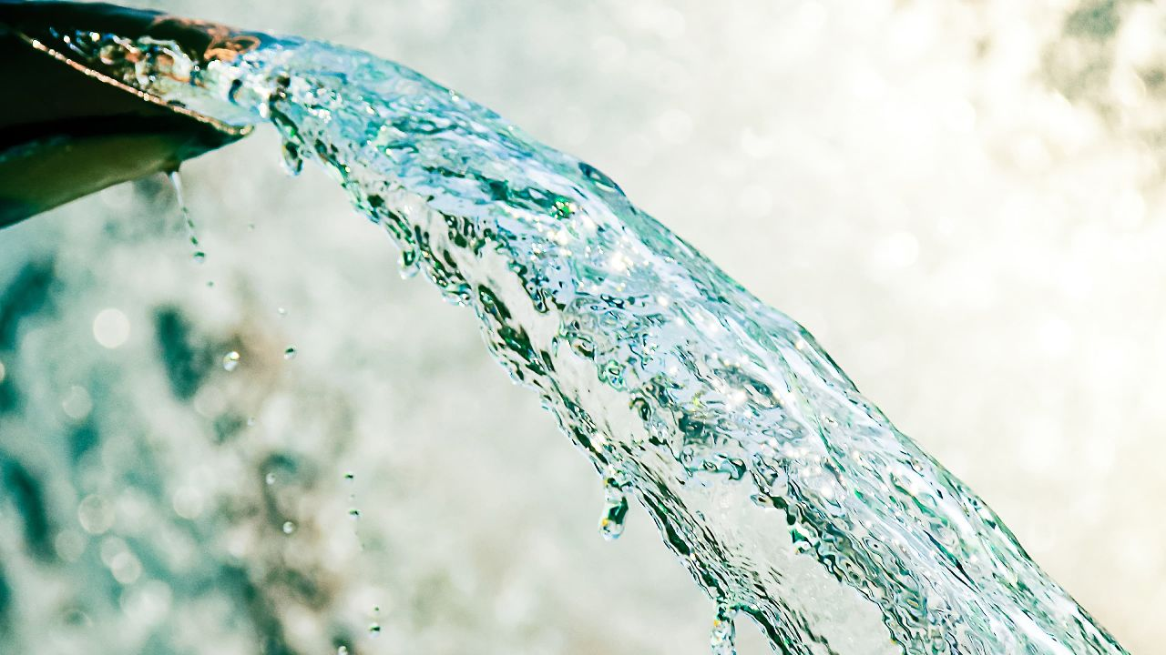
WATER MANAGEMENT

Slide 4
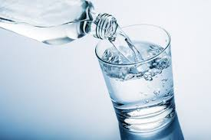
DEFINITIONS
Management = The organization and coordination of the activities of a business in order to achieve defined objectives
Resources = A stock or supply of money, materials, staff, and other assets
Safe water = Potable water free from harmful microorganisms and substances
Freshwater = Water whose low salinity allows consumption. It is the water of rivers, lakes, rain, glaciers, peat bogs, etc. as opposed to seawater

Slide 5
DEFINITIONS
Water management is the activity of planning, developing, distributing an optimum use of water resources under defined water polices and regulations. It includes: management of water treatment of drinking water, industrial water, sewage or wastewater, management of water resources, management of flood protection, management of irrigation, and management of the water table.

Slide 6
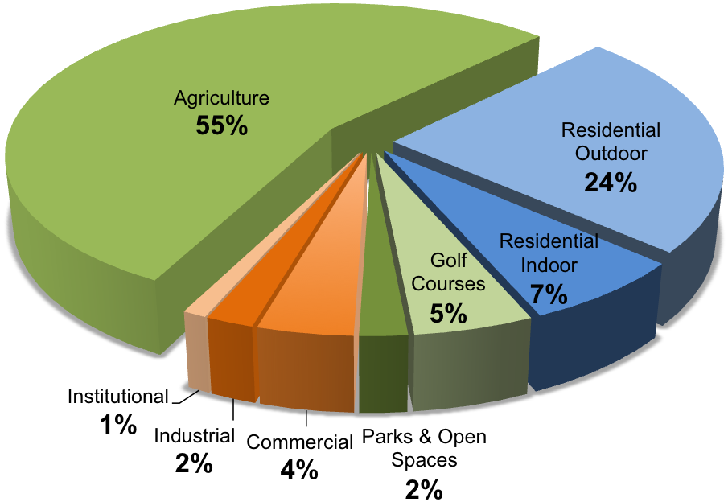
USE OF WATER
Pie chart showing the different uses of water in %
Commercial use
Domestic use
Industries
Irrigation
Live stock
Minning
Public supply
http://www.waterencyclopedia.com/Tw-Z/Uses-of-Water.html
http://www.obwb.ca/wsd/key-findings/water-use

Slide 7
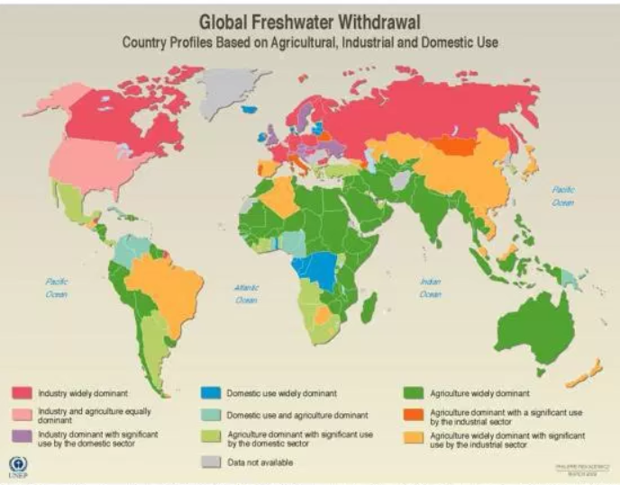
USE OF WATER

Slide 8
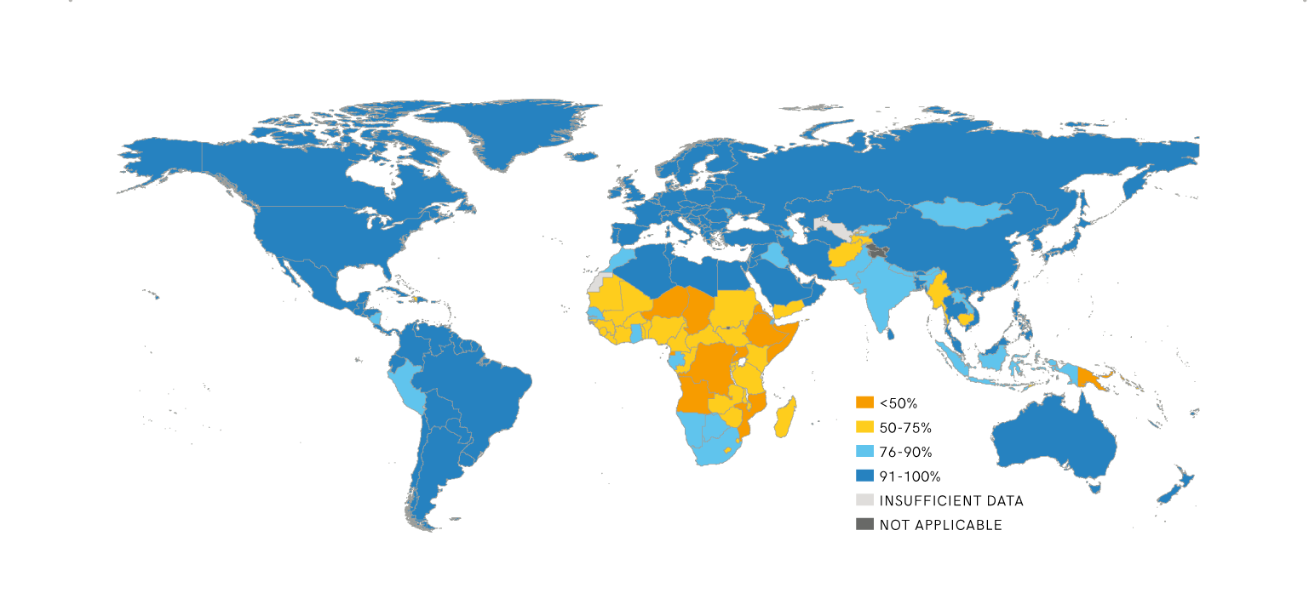
ACCESS TO WATER
World's map showing the access to safe water depending on the country in 2015
WHO/UNICEF JMP Progress on Drinking Water, Sanitation and Hygiene: 2017 Update and SDG baseline
https://data.unicef.org/topic/water-and-sanitation/drinking-water/

Slide 9
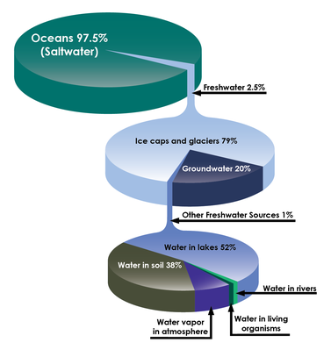
WATER DISTRIBUTION in THE WORLD
PIE CHART LISTING THE WATER DISTRIBUTION IN THE WORLD

Slide 10
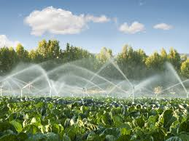
PROBLEMS
Water in Agriculture
Agriculture consumes nearly 70% of the total available water.
Excessive utilization for irrigation from undergrounds water. It has caused a drastic decrease in the volume of aquifers, increasing the costs of water extraction and irrigation per hectare.

Slide 11
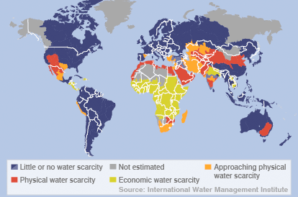
PROBLEMS
Water scarcity = lack of fresh water resources to meet water demand
​Causes : Overuse, pollution, conflict, distance, drought, governmental access
Effects : lack of access to drinking water, hunger, lack of education, diseases, sanitation issues, poverty

Slide 12
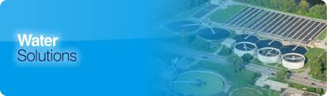
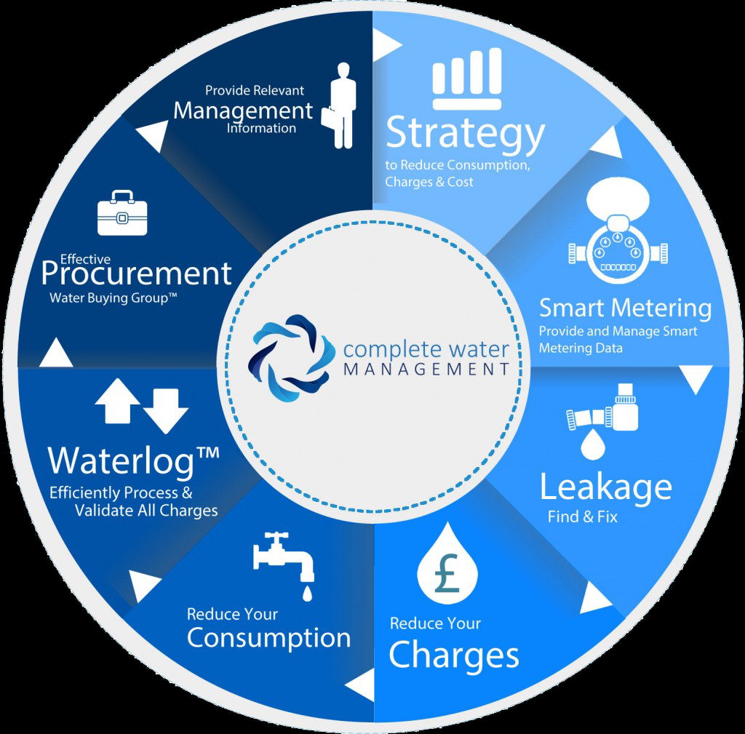
SOLUTIONS
Education
Recycle Water
Advance Technology Related to Water
Improve Practices Related to Farming
Clean Water Initiatives

Slide 13
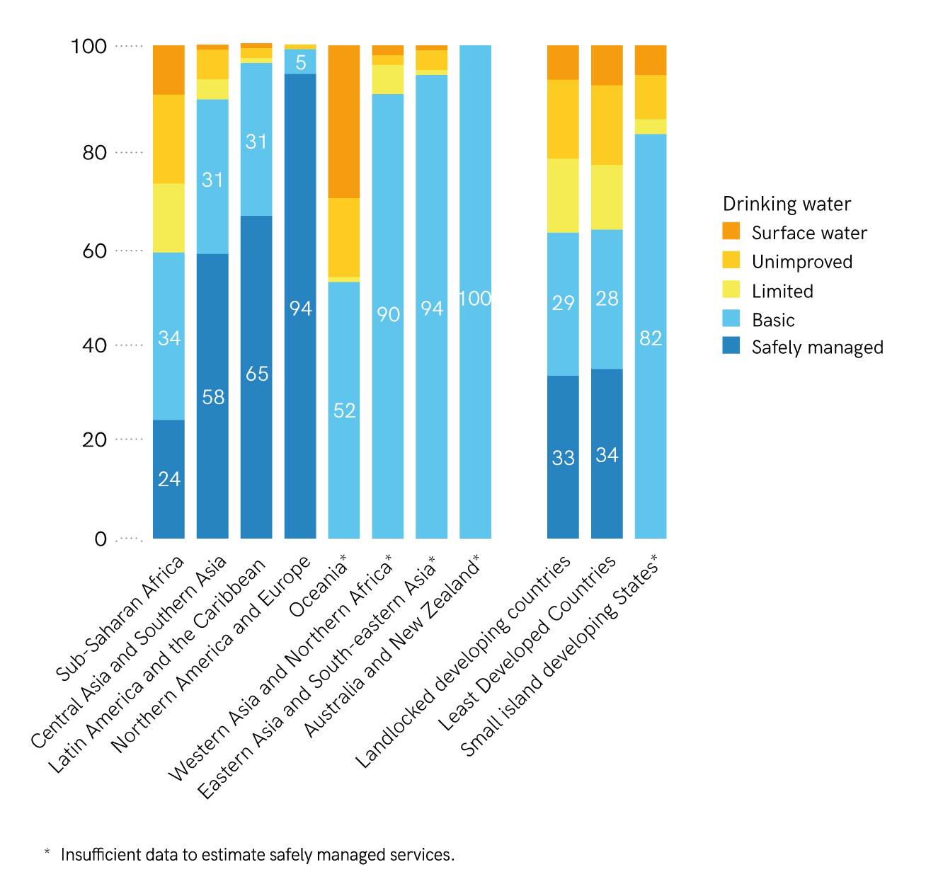
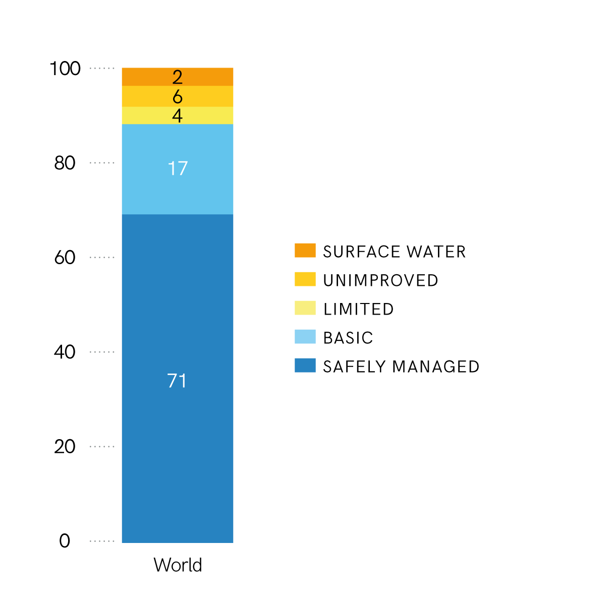
COMPARATIVE STATISTICS
Global drinking water ladder in 2015, by SDG region
Drinking water ladder in 2015, by SDG region

Slide 14
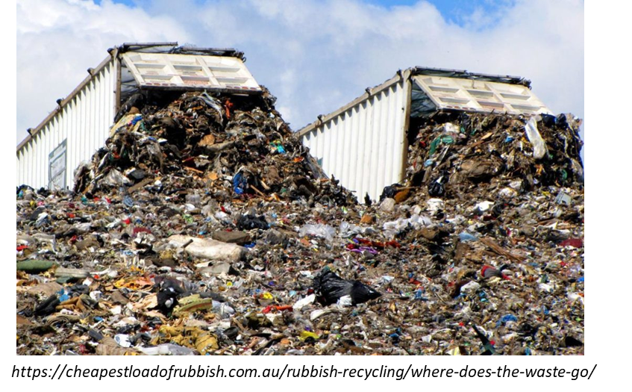
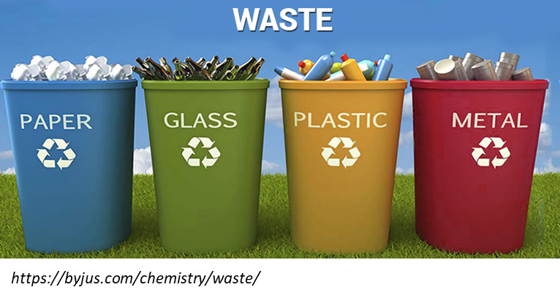
DEFINITIONS
Waste = Unwanted or unusable material, substances, or by-products
Waste management is all the activities and actions required to manage waste from its inception to its final disposal. This includes amongst of other things, collection, transport, treatment and disposal of waste together with monitoring and regulation.

Slide 15
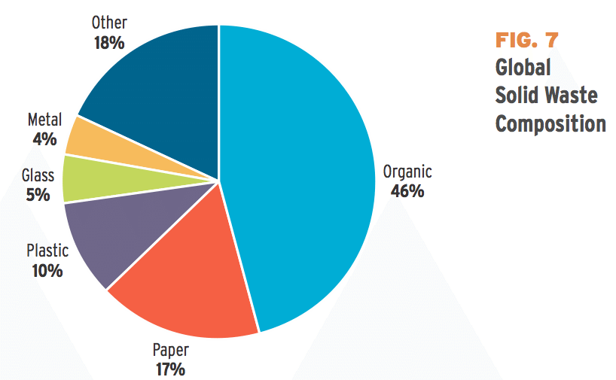
CLASSIFICATION of WASTE
Pie chart presenting the classification of waste
• Biodegradable/organic waste
• Recyclable materials (dry waste)
• Inert waste
• Electrical and electronic waste
• Composite waste
• Hazardous waste
• Biomedical waste
https://www.theatlantic.com/business/archive/2012/06/26-trillion-pounds-of-garbage-where-does-the-worlds-trash-go/258234/

Slide 16
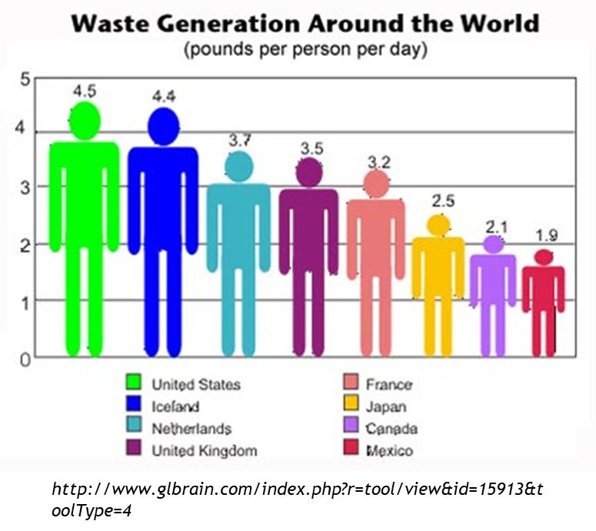
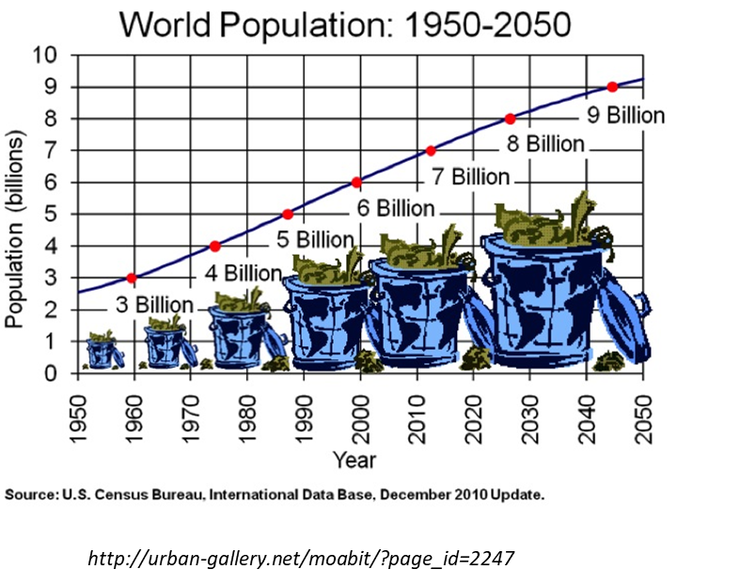
WASTE PRODUCTION
Chart outlining the waste production around the world
Line chart depicting the evolution of waste production in the world

Slide 17
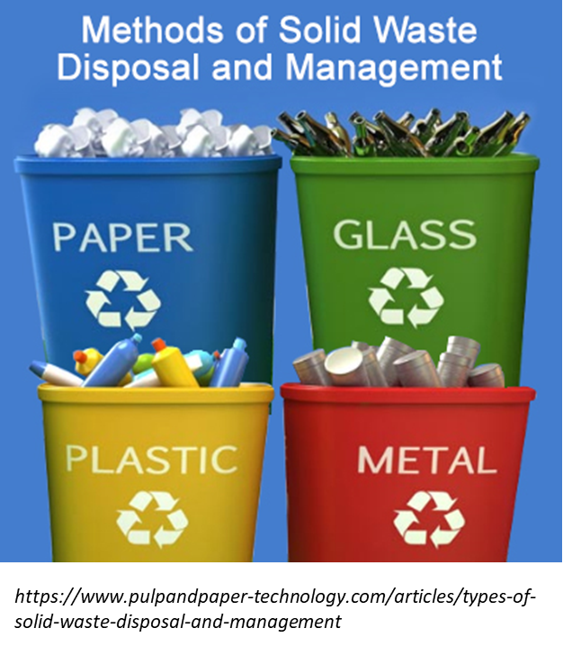
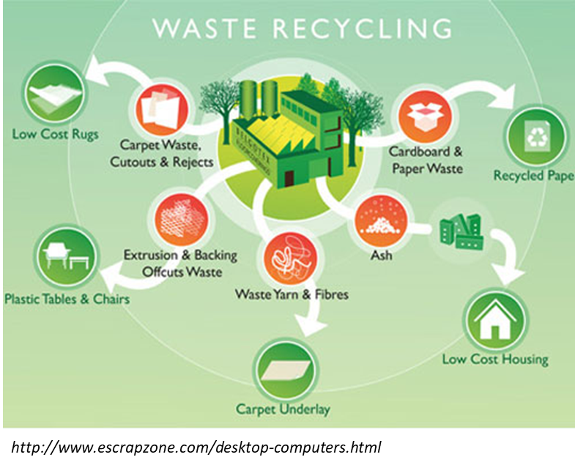
WASTE DISPOSAL
What do we do with waste ?

Slide 18


CONCLUSION

Slide 19
BIBLIOGRAPHY
http://www.waterencyclopedia.com/Tw-Z/Uses-of-Water.html#ixzz595BL1i3R
https://en.wikipedia.org/wiki/Water_distribution_on_Earth
https://en.wikipedia.org/wiki/Waste_management
http://www.businessdictionary.com/definition/management.html
https://en.oxforddictionaries.com/definition/resource
http://www.businessdictionary.com/definition/safe-water.html
https://en.oxforddictionaries.com/definition/waste
https://www.nature.com/news/environment-waste-production-must-peak-this-century-1.14032
https://www.eea.europa.eu/publications/92-826-5409-5/page036new.html => waste disposal
https://data.unicef.org/topic/water-and-sanitation/drinking-water/ => comparative statistics
https://www.conserve-energy-future.com/causes-effects-solutions-of-water-scarcity.php
https://www.theguardian.com/global-development-professionals-network/2017/feb/13/global-water-crisis-innovation-solution
https://www.conserve-energy-future.com/causes-effects-solutions-of-water-scarcity.php

Slide 20



THANK YOU FOR YOUR ATTENTION !
Do you have any questions ?

